Slide 1



CSI RenAIssance Hackathon
Shubhan Agrawal
Hrishikesh Kali Harshil Pahuja
Anshul Kumaria

Slide 2


Track– Creative Applications of Gen-A.I.
Automated Newspaper Summarizer – The A.I. Times

Slide 3

Introduction
This project uses multiple APIs to fetch the latest 24-hour news and uses Gen-AI to transform it into the format of a traditional newspaper. This innovation streamlines editorial workflows, making editors' tasks more efficient. Additionally, it provides users with easy access to news from diverse sources, all in one place.​
The seamless integration of APIs, PDF generation, and image processing to create an aesthetically pleasing and informative document has been displayed here.​

Slide 4

Problem Statement :
To design a professional PDF newsletter, The AI Times, using Gen-AI and APIs to curate and feature trending news articles, providing a powerful tool for editors and publishers to streamline their journalism efforts and deliver impactful, engaging content to their audience.
Detailed Solution for the Problem Statement:
The solution automates the creation of a professional PDF newsletter by integrating multiple technologies. It fetches the latest news from the past 24 hours using NewsAPI and generates visually appealing illustrations for the corresponding headlines using Worqhat Gen AI. Summaries of the news articles are created for easy readability, and the final output is structured into a polished, aesthetically pleasing PDF layout with clickable links for further exploration. The system seamlessly combines content aggregation, visual design, and automation to deliver a streamlined and engaging user experience.
​

Slide 5

How Does The Solution Address The Problem?
The solution simplifies the process of creating newsletters by automating time-consuming tasks such as data collection, content summarization, and design formatting. By integrating APIs for data fetching and image generation, it ensures relevant and engaging content.
Innovation and Uniqueness of the Solution: This solution stands out due to its seamless integration of content aggregation, categorization, and visual enhancement in one automated workflow. Unlike traditional newsletter creation tools, it dynamically generates summaries and visuals tailored to the content, reducing manual effort.

Slide 6
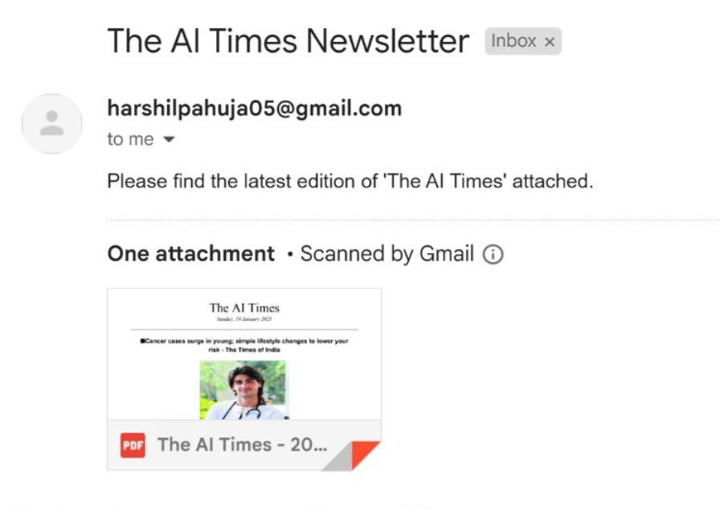
Features
Automated daily updates:
Streamlined News Delivery:
The system is hosted to run daily and automatically send a detailed mail.
Generate a newspaper-style PDF with trending and verified news, making it easy to consume.
Verified News At Your Fingertips:
Short And Sweet Morning Newsletter:
Provide access to verified news with credible sources across internet, eliminating the need to visit multiple sites for fact-checking.
The PDF is made in a manner so that only top news across internet is delivered to your mail to keep you updated.

Slide 7

Dynamic Website: Plan to launch a website that updates news automatically every hour, ensuring real-time information.
Expanded Customization: Potential for users to filter news by category, region, or relevance.
Future Features
Autonomous Systems
Continued development of self-learning and self-optimizing AI systems.
Human-AI Collaboration
Enhancing human capabilities through AI augmentation rather than replacement.

Slide 8







TECH STACK
The following technologies were utilized in building this project:
1)Python: Core programming language for logic and automation.
2)ReportLab Library: Used for generating high-quality PDFs.
3)NewsAPI: Enables fetching of trending and verified news articles.
4)Worqhat API (Image Gen V2): Provides AI-generated images to enhance visual appeal.
5)smtplib- Used to send the newsletter on the email id
PYTHON
NewsAPI
ReportLab Library
Smtplib
Worqhat API

Slide 9
Code Functionality
Fetch trending news articles using NewsAPI.
Generate detailed summaries for each news article.
Use WorqHat API to generate images related to the articles.
Compile the news, images, and summaries into a professional PDF.
6)
The PDF is then sent onto the Email ID each morning automatically.
Ensure reusability with unique file handling techniques.
Implement robust error handling to ensure smooth operation. If an image already exists, the code will intelligently detect the existing file and avoid redundant downloads or overwrites, providing a seamless user experience.
Some extra API's used
1)Requests Library
API Requests
Used for making HTTP requests to interact with APIs, such as fetching news data or images.
2)Hashlib and os
File Handling and Unique Naming
Hashlib is used to generate unique hash values for filenames.
os is used to handle file paths and manage directories.
3)pytz
Timezone Management
Allows for easy handling of timezones, ensuring correct timestamps across different regions.

